Slide 1


GROUP 6
PRESENTATION
STOCK MARKET ANALYSIS

Slide 2
TEAM MEMBERS
AMRUTHA B R
AJINKYA JALINDAR JAKATE
KAVANA GIDDI B L
PALAS PROBHAS BELEL
PREETHI N
ROSHAN RAJESH YADAV
RUTIK SUNIL SHINDE

Slide 3

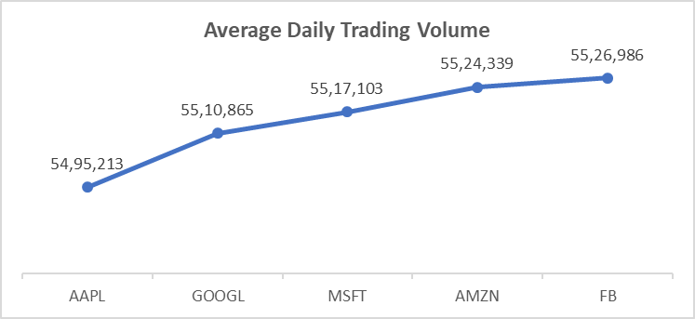
Average Daily Trading Volume
The Average Daily Trading Volume (ADTV) is a measure used in financial markets to gauge the typical number of shares traded in a security over a specified period, typically one trading day. Here's a breakdown of its components:
Volume: Volume refers to the total number of shares (or contracts) traded during a specific period, typically a trading day. It's a measure of market activity and liquidity.
Average: This indicates that the volume is averaged over a certain period, usually calculated over a specific timeframe such as 30 days, 90 days, or even a year.

Slide 4
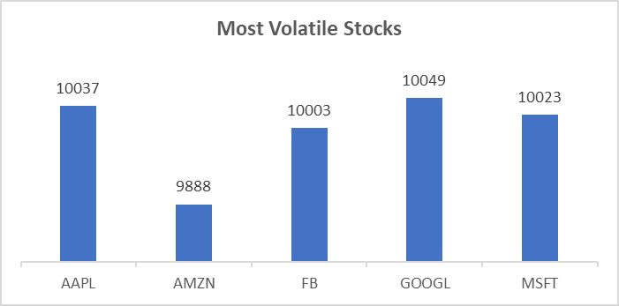
Most Volatile Stocks
Most volatile stocks are those that experience significant price fluctuations over a given period, often in a short amount of time. Volatility refers to the degree of variation in a stock's trading price over time. Here's a simple breakdown :
Price Fluctuations: Volatility means that the stock's price goes up and down rapidly. Some stocks may have big swings in price within a single day or over a few days.
Risk and Reward: Generally, more volatile stocks are riskier because their prices can change dramatically, making it harder to predict their future movements. However, they can also offer higher potential returns if the investor correctly anticipates and reacts to price changes.

Slide 5
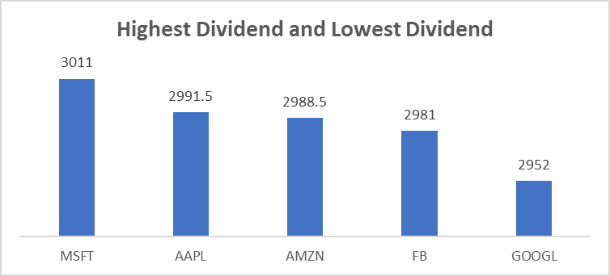
Stocks with Highest Dividend and Lowest Dividend:
Stocks with the highest dividends typically belong to companies that consistently distribute a significant portion of their earnings to shareholders in the form of dividends.
These companies are often mature, stable, and have a history of generating steady profits.
Investors seeking income from their investments often favor high-dividend stocks as they provide regular cash payments, which can supplement their income or be reinvested for growth.

Slide 6
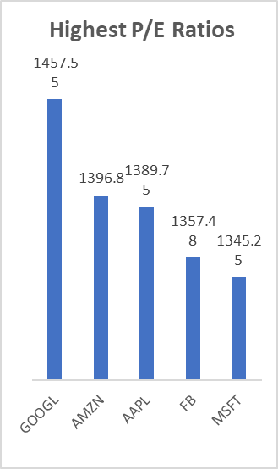
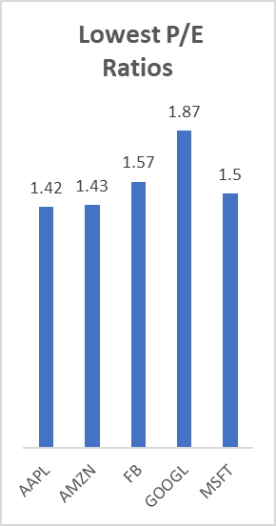
Highest and Lowest P/E Ratios:
Stocks with the highest Price-to-Earnings (P/E) ratios typically represent companies whose stock prices are high relative to their earnings per share (EPS).
A high P/E ratio could indicate that investors are expecting high growth rates in the future or have high expectations for the company's performance.
These stocks are often from industries or sectors that are experiencing rapid growth or are considered to be in high demand.

Slide 7
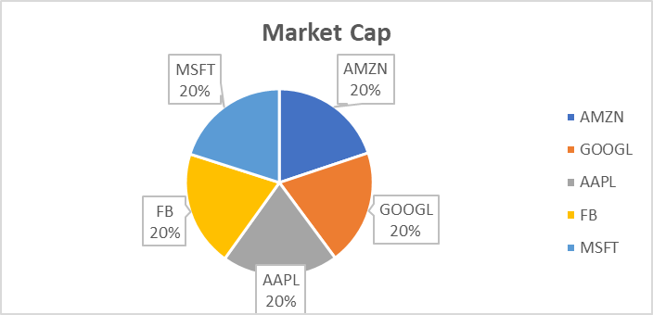
Stocks with Highest Market Capital
Stocks with the highest market capitalization are those belonging to companies that have the highest total value in the stock market.
Market capitalization, often referred to as "market cap," is calculated by multiplying a company's total outstanding shares by its current stock price.
Essentially, it represents the total dollar value of a company's outstanding shares of stock.
Companies with the highest market capitalization are typically large, well-established firms with significant operations, strong financial performance, and often global brand recognition.

Slide 8
Stocks Near 52 Week High
Stocks Near 52 Week Low
When a stock is near its 52-week high, it suggests that investors are optimistic about the company's prospects, as the price is approaching recent highs.
It may also indicate that the company has been performing well recently or has positive news or earnings announcements driving up the stock price.
Investors might see stocks near their 52-week highs as potential indicators of continued growth or momentum in the stock price.
When a stock is near its 52-week low, it suggests that investors may be pessimistic about the company's prospects or that there may be underlying issues affecting its performance.
It could indicate that the company has faced challenges, such as poor earnings, negative news, or a general downturn in its industry.
Investors might see stocks near their 52-week low as potentially undervalued opportunities, believing that the stock price could rebound in the future.

Slide 9
Stocks with Strong Buy Signals and stocks with Strong Selling Signal:
Stocks with strong buy signals are those that analysts or trading algorithms have identified as having favourable conditions for purchasing.
These signals typically arise from various technical or fundamental factors that suggest the stock's price may rise in the near future
For example, strong buy signals might stem from positive earnings reports, bullish technical indicators like moving averages or chart patterns, or favourable industry trends.
Investors who receive these signals may interpret them as opportunities to buy the stock, believing that its price will increase, potentially leading to profits.

Slide 10
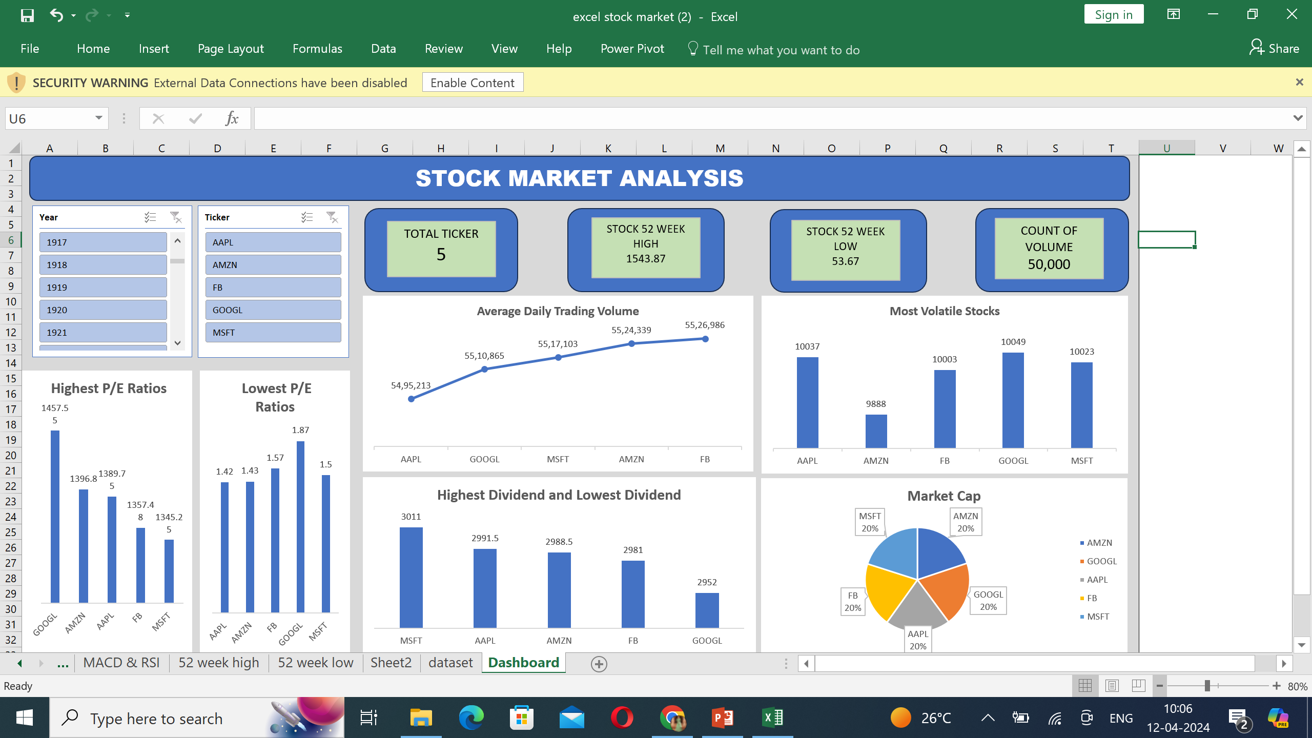

Slide 11
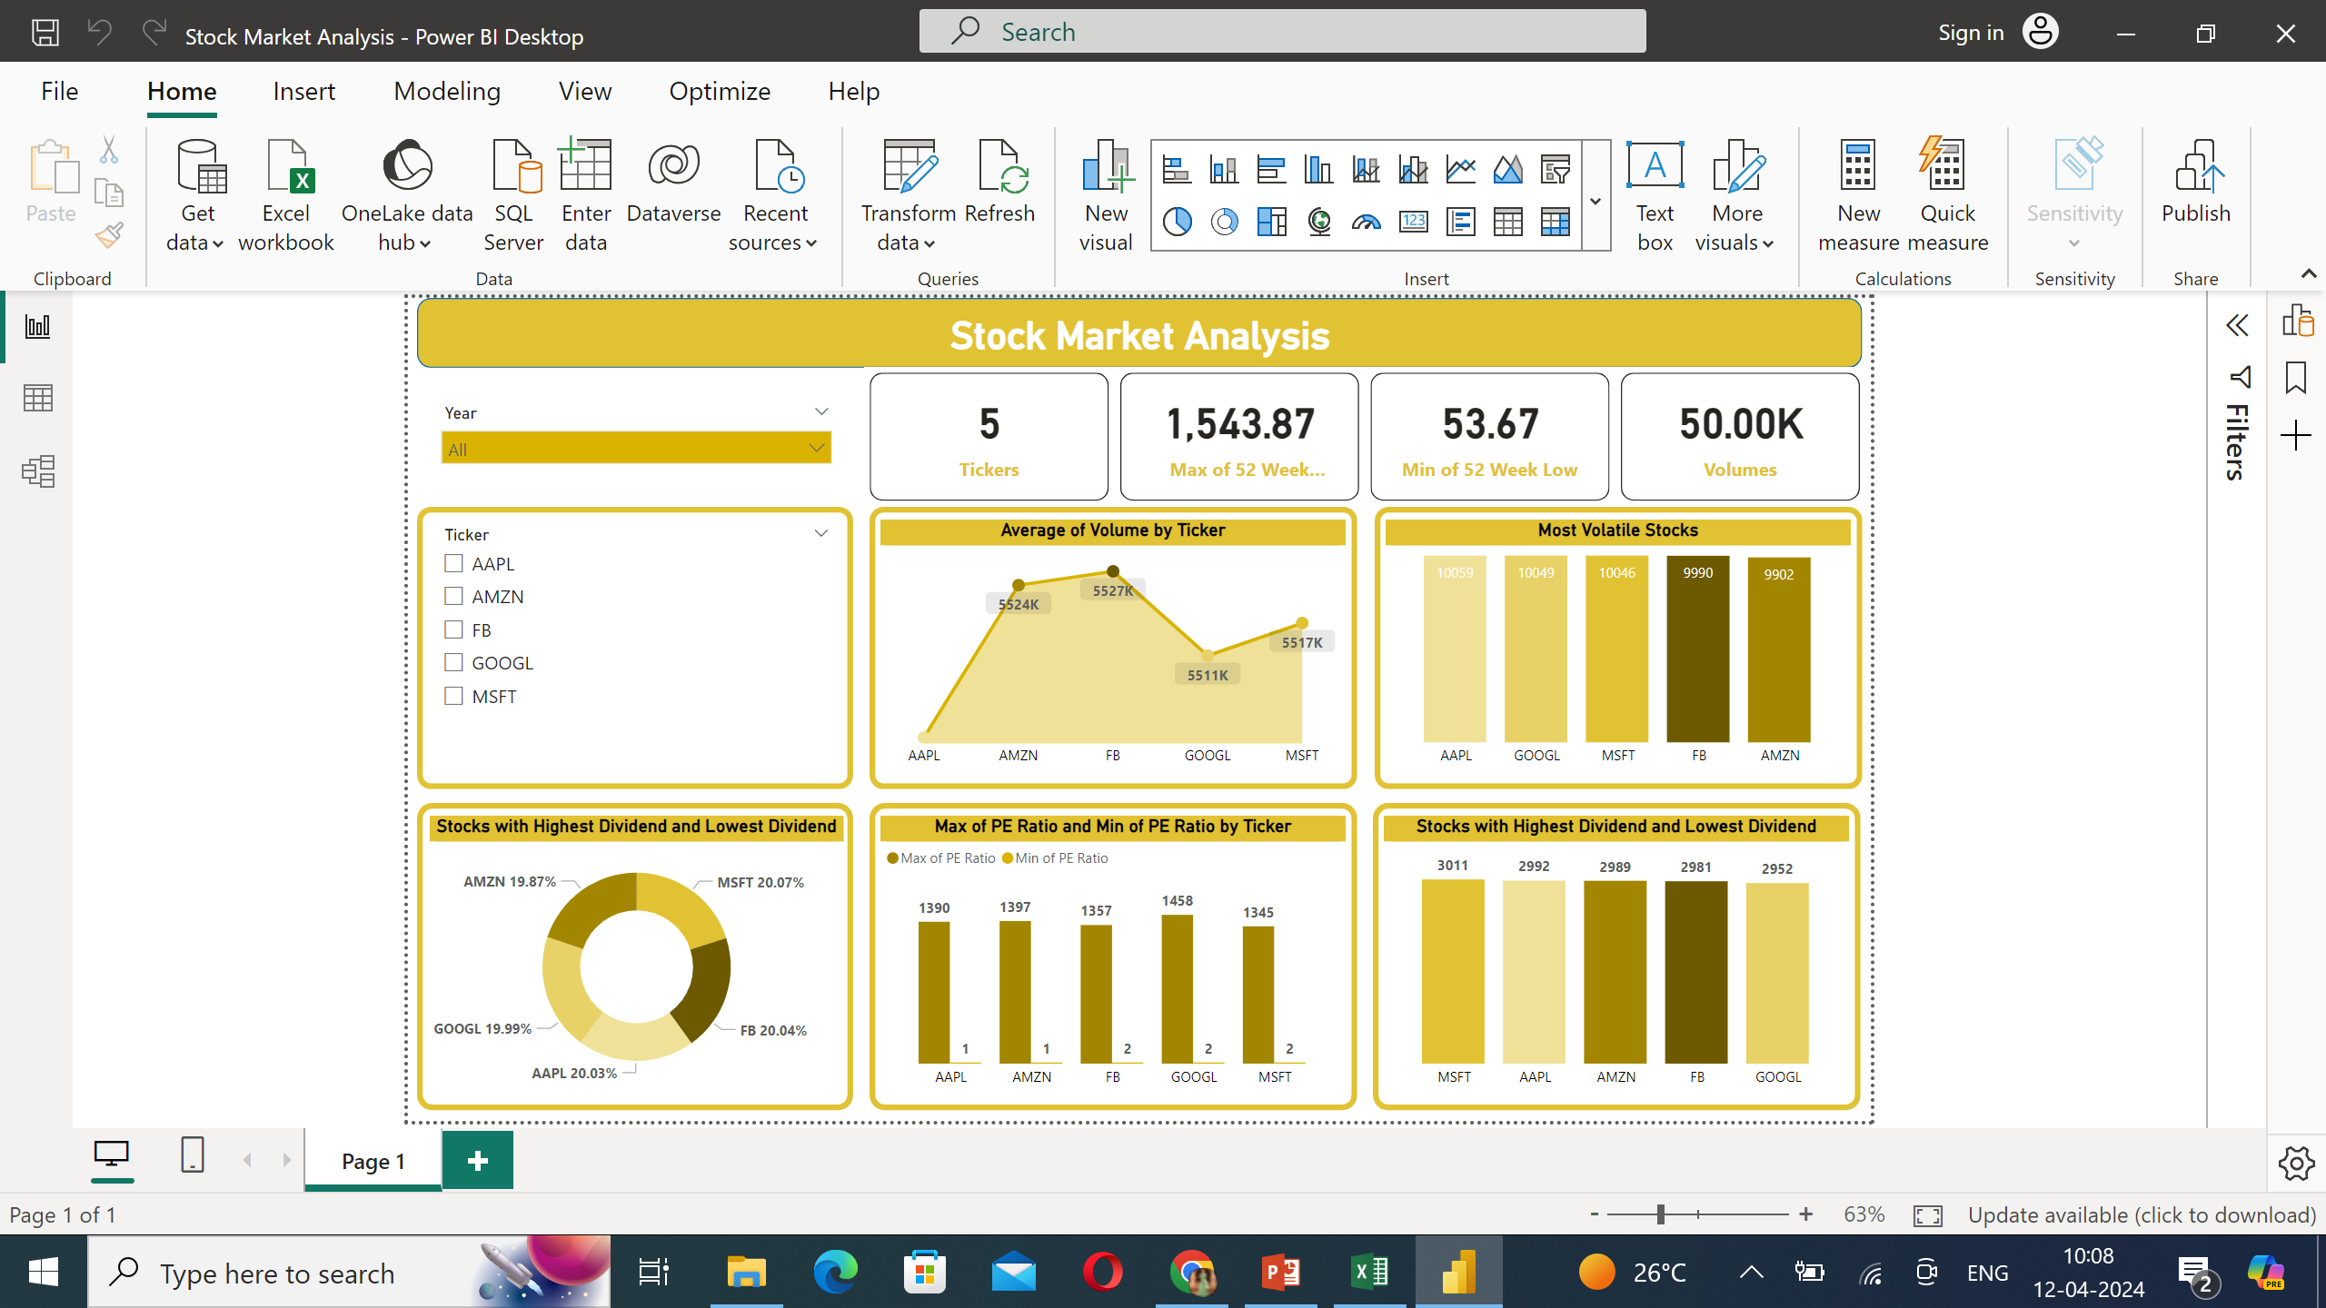

Slide 12
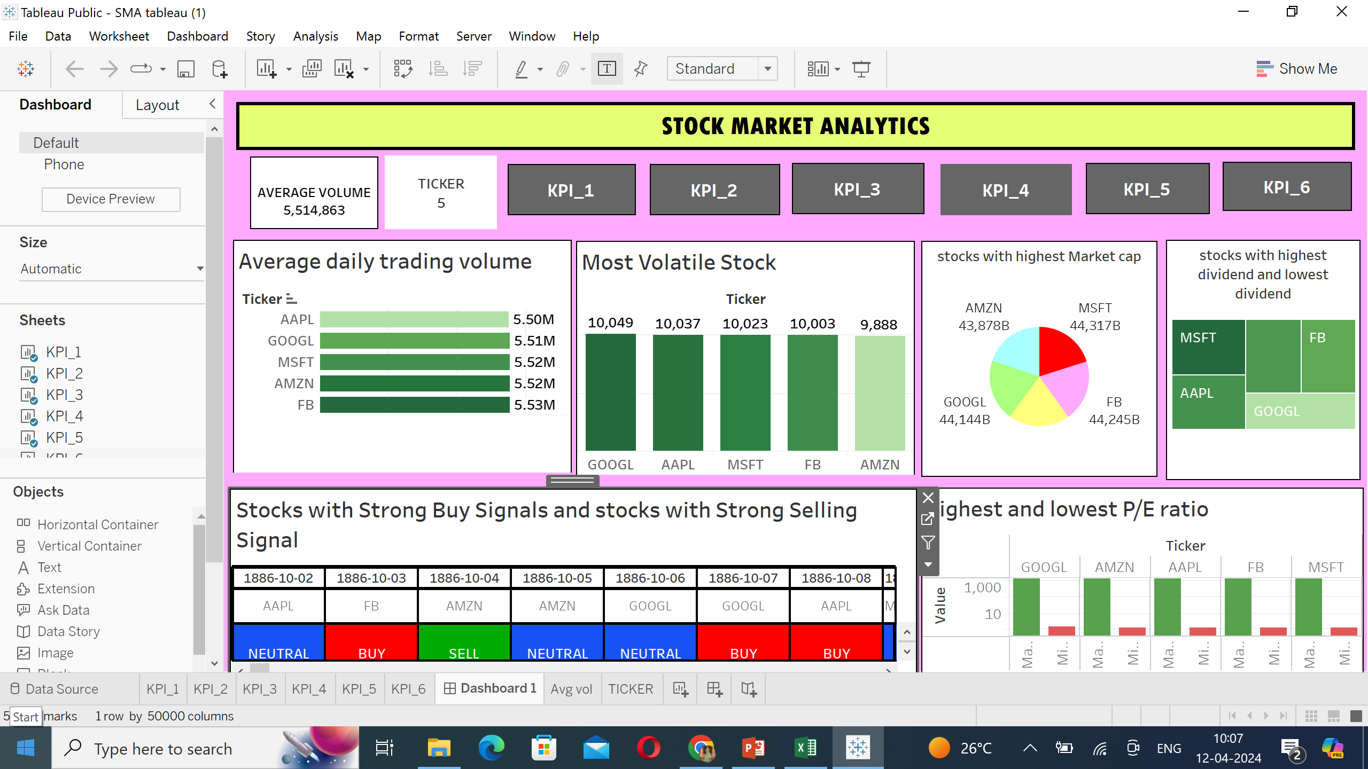

Slide 13
CONCLUSION
When it comes to the stock market, a variety of factors influence investors' decisions. Some seek high trading volumes for liquidity, while others chase volatility for potential gains. Investors interested in dividends might focus on stocks with the highest and lowest dividend yields, aiming for consistent income or growth. P/E ratios provide insight into a company's valuation, with some preferring high ratios for growth potential and others favouring lower ones for perceived value. Market capitalization indicates the size of a company, attracting investors seeking stability or growth opportunities. Stocks near their 52-week highs or lows may indicate momentum or potential reversals, depending on investors' strategies. Lastly, buy and sell signals can guide investors, signalling potential opportunities or risks in the market. In conclusion, investors must consider these various factors, aligning them with their investment goals and risk tolerance to make informed decisions in the dynamic world of stock trading.

Slide 14
THANK YOU

